Slide 1
Introduction to Neural Networks
Aviral Mansingka
amansin@purdue.edu
git clone https://github.com/aviralmansingka/nn

Slide 2
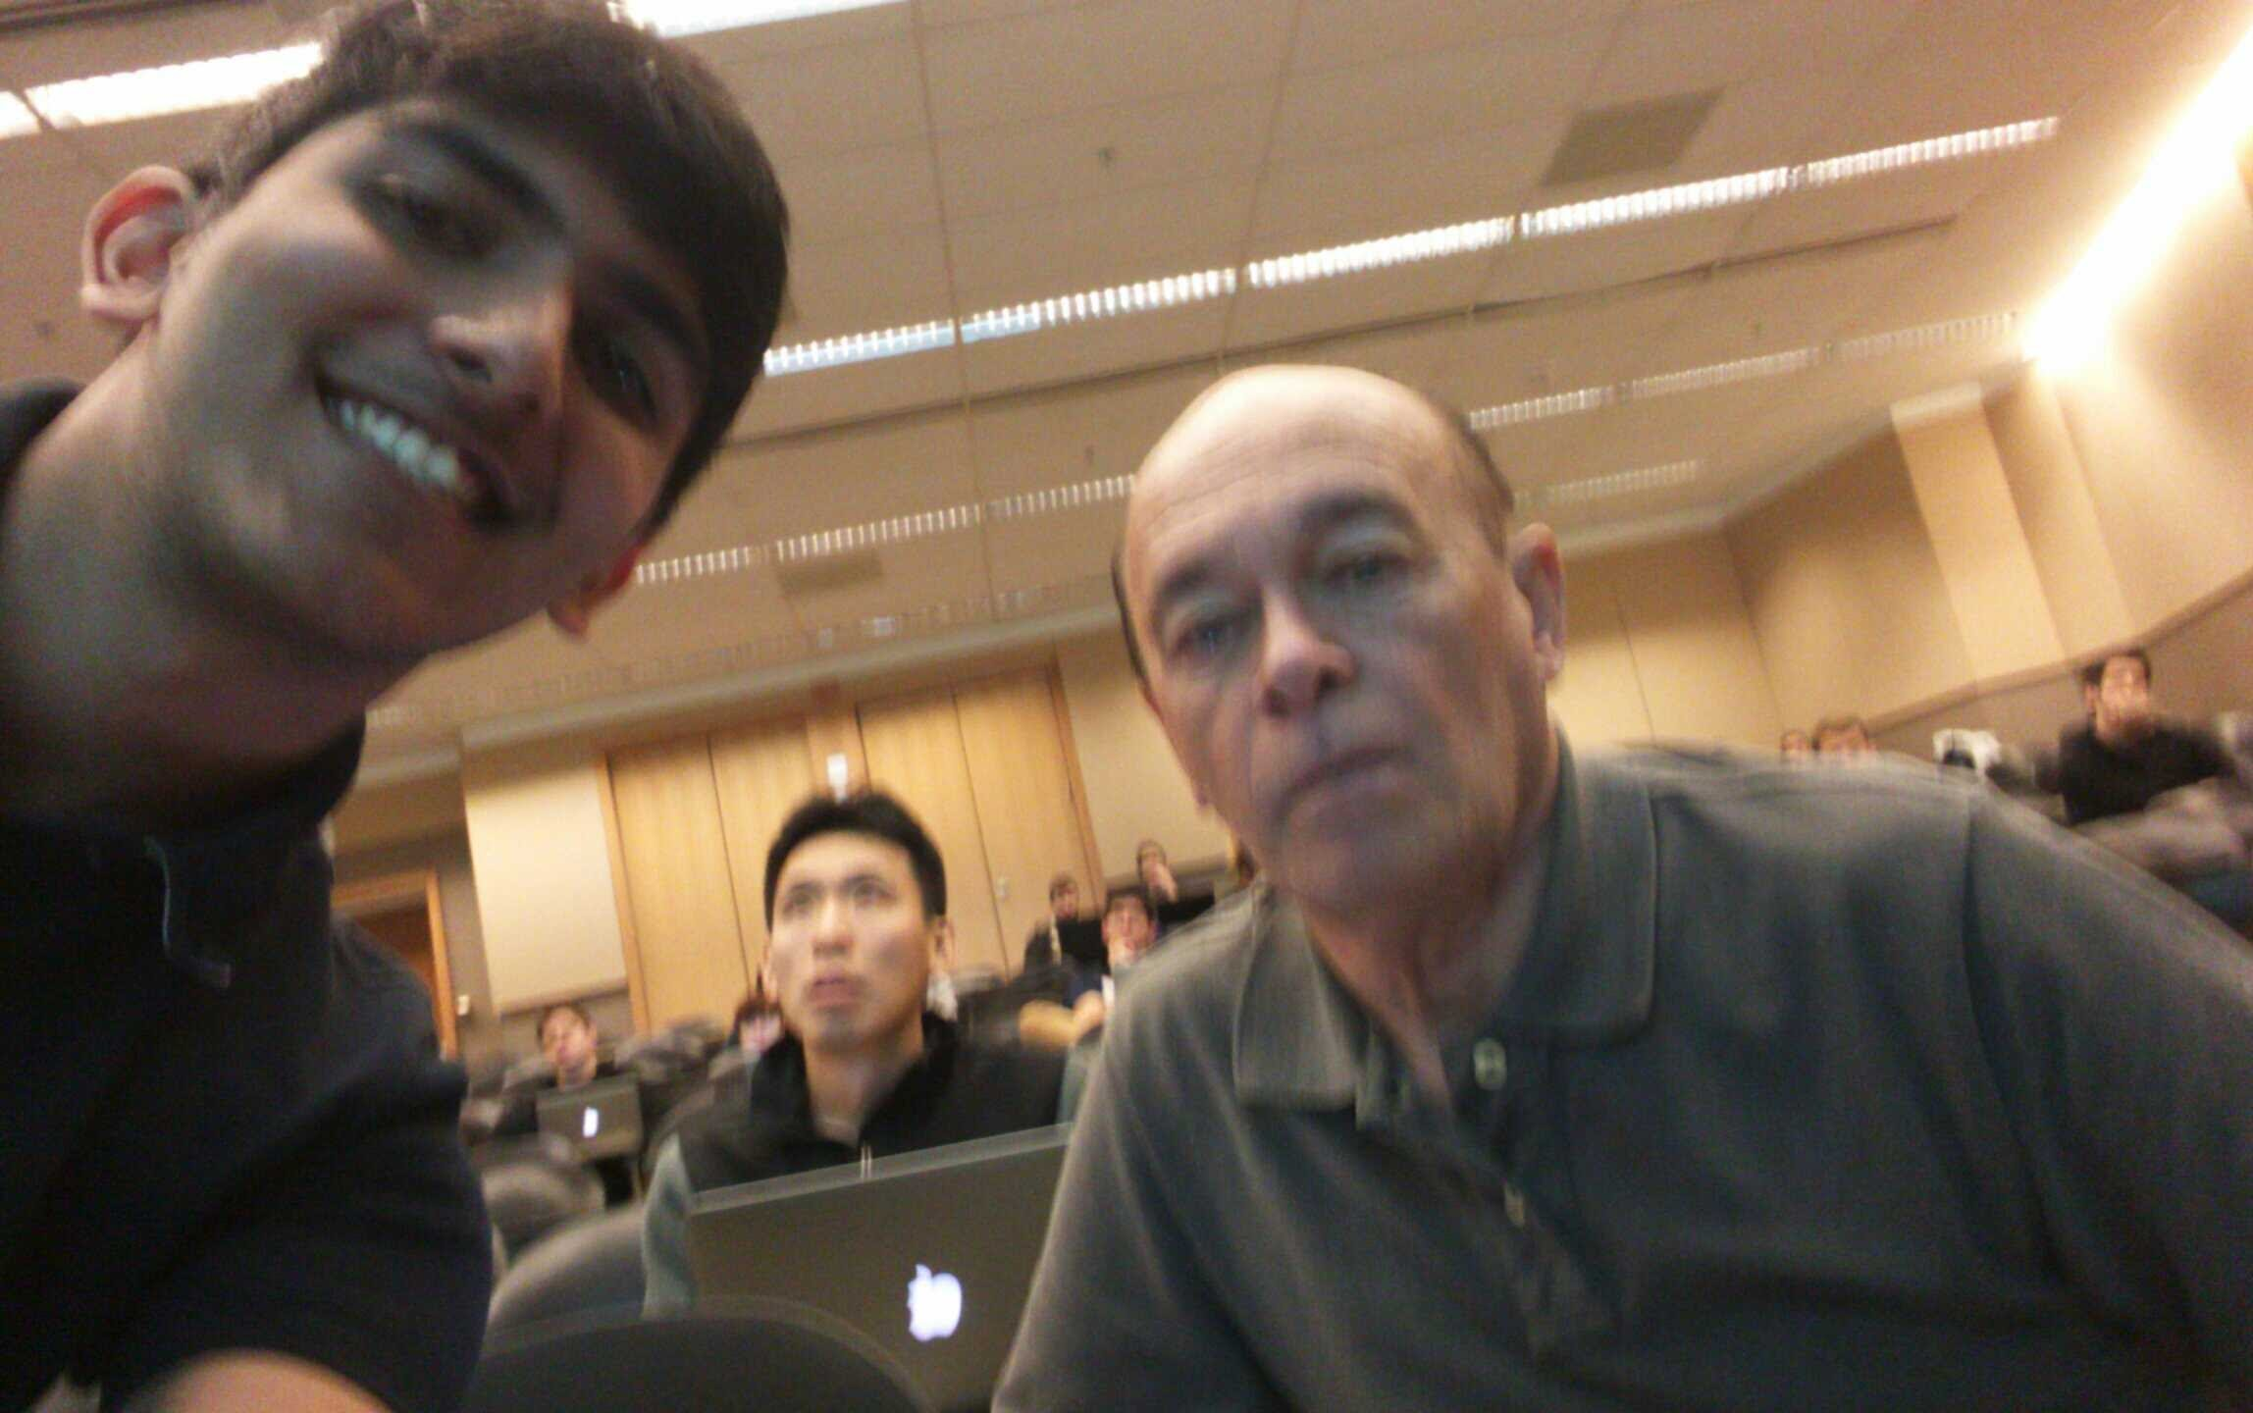
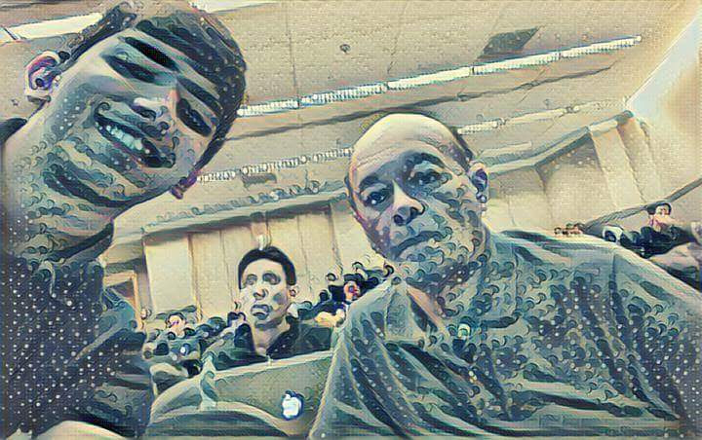
Little about me
I’m a sophomore!
Started learning about machine learning and neural networks little less than a year ago
Interning at Yelp’s Data Mining and Search team
Built a neural network to stylize images in pretty ways

Slide 3
What am I going to learn today?
Fundamental math required to understand Neural Networks
Main types of problems in Machine Learning
Neural Networks! (and some of their applications in detail)
Start-to-finish programming of neural networks
A mild introduction to Deep Learning
How to make pictures great again! (if time permits)

Slide 4
What do I need to know to begin?
Basic Linear Algebra (Dot Products)
A willingness to learn something fantastic
THAT’S IT!

Slide 5


Dot Products

Slide 6
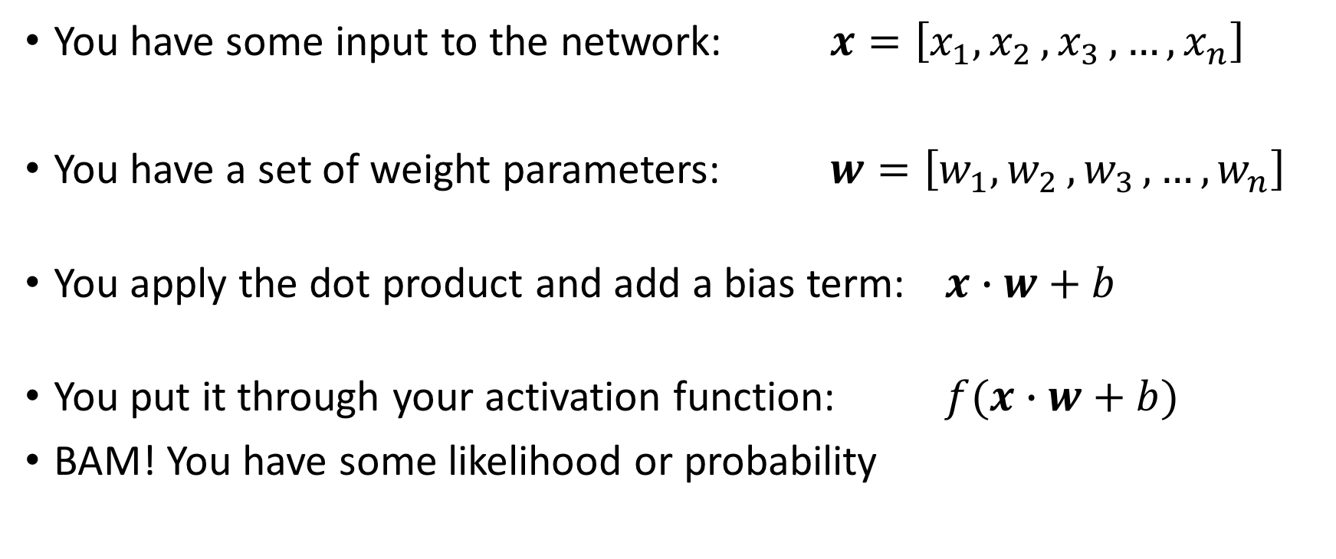
What is a Neural Network?
You have some input to the network: $x=\left[x_{1}{,x}_{2}{,x}_{3},…,x_{n}\right]$
You have a set of weight parameters: $w=\left[w_{1}{,w}_{2}{,w}_{3},…,w_{n}\right]$
You apply the dot product and add a bias term: $x∙w+b$
You put it through your activation function: $f(x∙w+b)$
BAM! You have some likelihood or probability

Slide 7
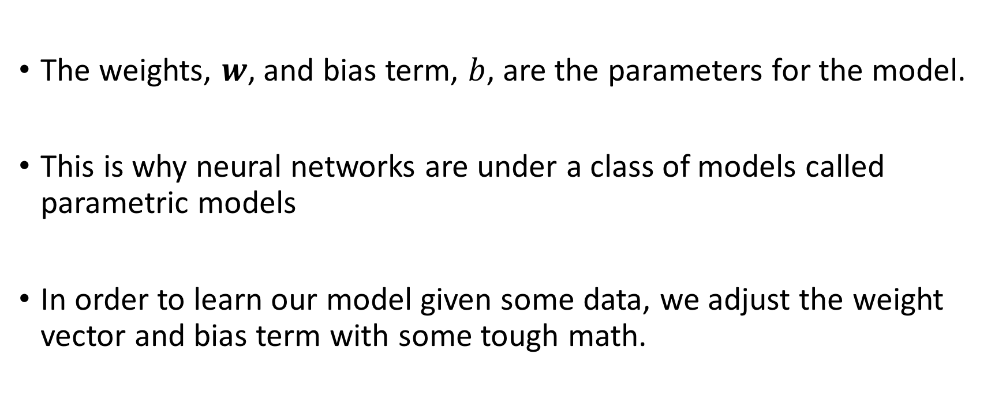
What is a Neural Network?
The weights, $w$, and bias term, $b$, are the parameters for the model.
This is why neural networks are under a class of models called parametric models
In order to learn our model given some data, we adjust the weight vector and bias term with some tough math.

Slide 8
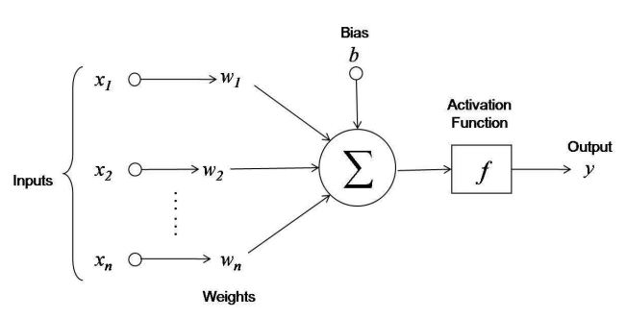
What is a Neural Network?

Slide 9
What’s with the hype on these so called ’Neural Networks’ ?
Bias vs. Variance Tradeoff
Adaptability and Applications

Slide 10
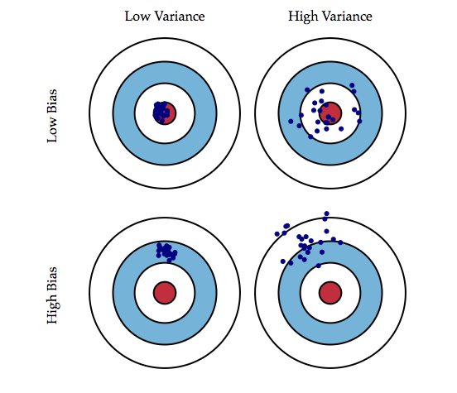
Bias vs. Variance

Slide 11
Bias vs. Variance
Simpler models don’t learn the data well (Bias)
Complicated models don’t generalize well (Variance)
Neural Networks balance this well

Slide 12
Funky Applications
“A neural algorithm of artistic style” (Shown earlier)
Facebook’s facial recognition, Self Driving Car etc.
Relies mostly convolutional neural networks (CNNs), something we might be able to learn about
Predicting Diseases with IBM Watson

Slide 13
So… that’s why they are awesome!

Slide 14
Let’s talk application
So far we have learned about:
Models
Inputs
Class outputs
A machine learning algorithm needs something else, a loss function
It describes how far we are from our solution
Using this tensorflow will automatically update our parameters using Gradient Descent

Slide 15
Let’s talk application
Very popular neural networks framework called tensorflow
Using an idea called symbolic math, and ‘building a graph’ of computations
It’s super easy!

Slide 16
Let’s talk application
Neural Network are particularly great at classification
Given some data, they return a class label
We will talk about 2 datasets:
Pima Indians Diabetes Dataset
MNIST Handwritten Digit Classification

Slide 17
Pima Indians Dataset
Description: https://archive.ics.uci.edu/ml/datasets/Pima+Indians+Diabetes
Data: https://archive.ics.uci.edu/ml/machine-learning-databases/pima-indians-diabetes/pima-indians-diabetes.data

Slide 18
MNIST Handwritten Digits
Description: http://yann.lecun.com/exdb/mnist/

